Slide 1
HARBORSIDE ACADEMY
School Profile/Credentialing Portfolio

Slide 2
Index
Community Actions
Parent Satisfaction Survey (pgs. 4 - 12)
Harborside Charitable Donations (pgs.14)
Student Involvement (pg. 15)
Student Scholarships Earned (pg. 16 - 17)

Slide 3
Community Actions
Parent Satisfaction
Surveys
School Involvement
Recognition
Scholarships

Slide 4
Parent Satisfaction Survey 2013

Slide 13
School & Student Involvement

Slide 14
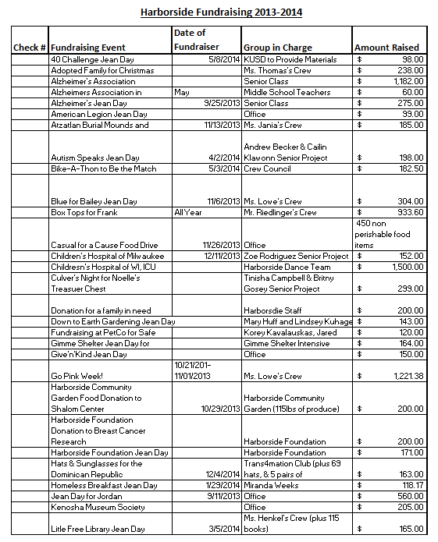
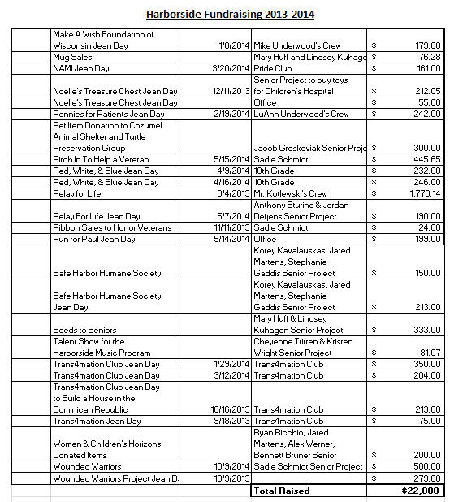
Harborside Charitable Donations 2013 - 2014

Slide 15
Harborside Student Participation in Extra/Co-Curricular Activities Per Year
 |  | Total Fall Enrollment | Pupils Participating | Participation Rate
2011-12 | Academic | 447 | 217 | 48.50%
 | Athletic | 447 | 166 | 37.10%
 | Music | 447 | 124 | 27.70%
2010-11 | Academic | 433 | 168 | 38.80%
 | Athletic | 433 | 120 | 27.70%
 | Music | 433 | 88 | 20.30%
2009-10 | Academic | 332 | 167 | 50.30%
 | Athletic | 332 | 94 | 28.30%
 | Music | 332 | 105 | 31.60%
2008-09 | Academic | 223 | 96 | 43.00%
 | Athletic | 223 | 121 | 54.30%
 | Music | 223 | 98 | 43.90%
2007-08 | Academic | 111 | 23 | 20.70%
 | Athletic | 111 | 36 | 32.40%
 | Music | 111 | 45 | 40.50%

Slide 16
Scholarships

Slide 17
Reported Scholarships Awarded to Harborside's Class of 2011
$1,027,115.00
Reported Scholarships Awarded to Harborside's Class of 2012
$783,800
Reported Scholarships Awarded to Harborside's Class of 2013
$724,380
Reported Scholarships Awarded to Harborside's Class of 2014
$850,000

